Slide 1

Safeguarding
in
Pictures

Slide 2






It is usual to follow advice, rules and instructions and take steps to …

Slide 3
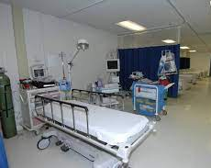
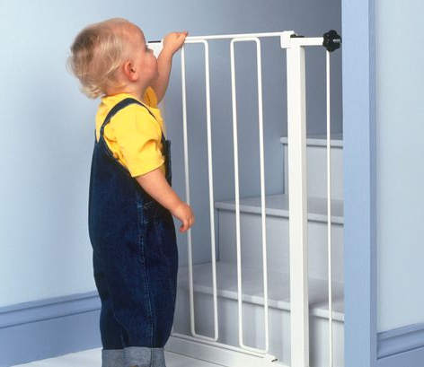
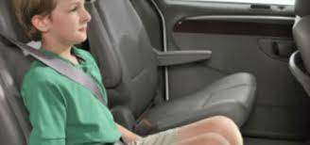
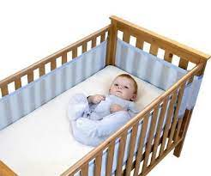
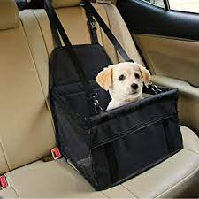
… protect the vulnerable.

Slide 4
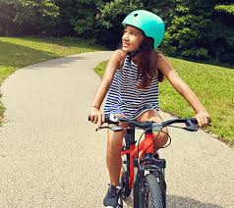
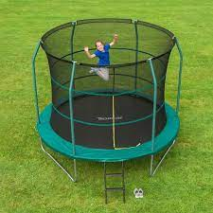
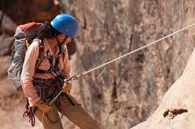
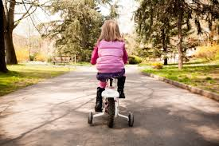
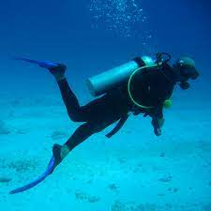
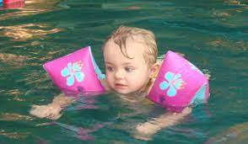
… protect us when we could be in danger.

Slide 5
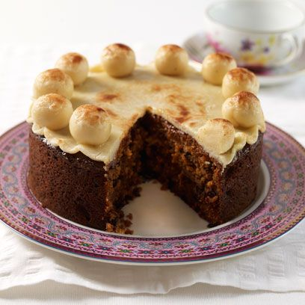

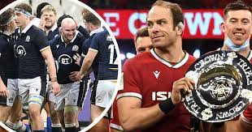
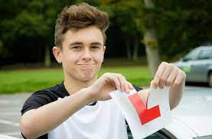
… ensure that everything works out well.

Slide 6
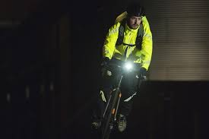
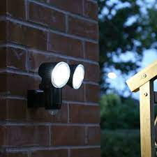
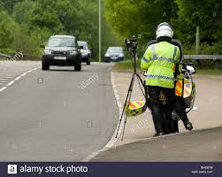
We also make sure that we can see and know what is happening …
…and be seen.
We signal that rule breaking is not acceptable.

Slide 7
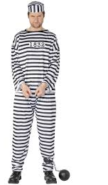
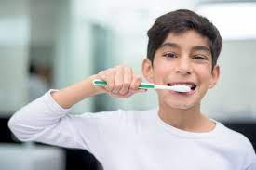

Safeguarding rules do not restrict us.
They are like a good habit which…

Slide 8
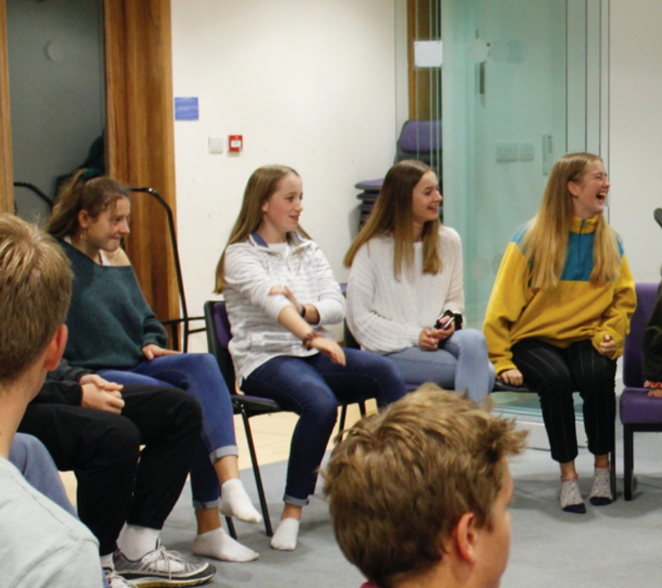
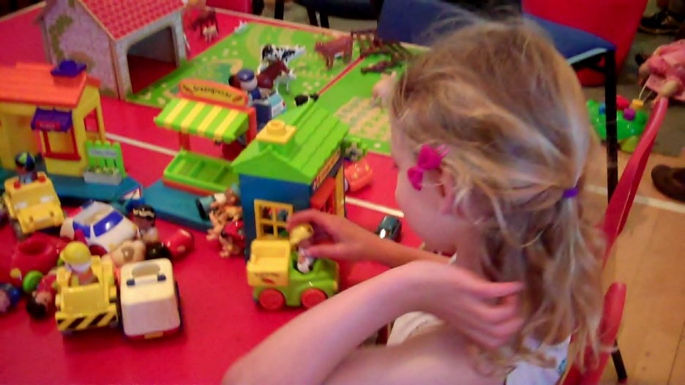
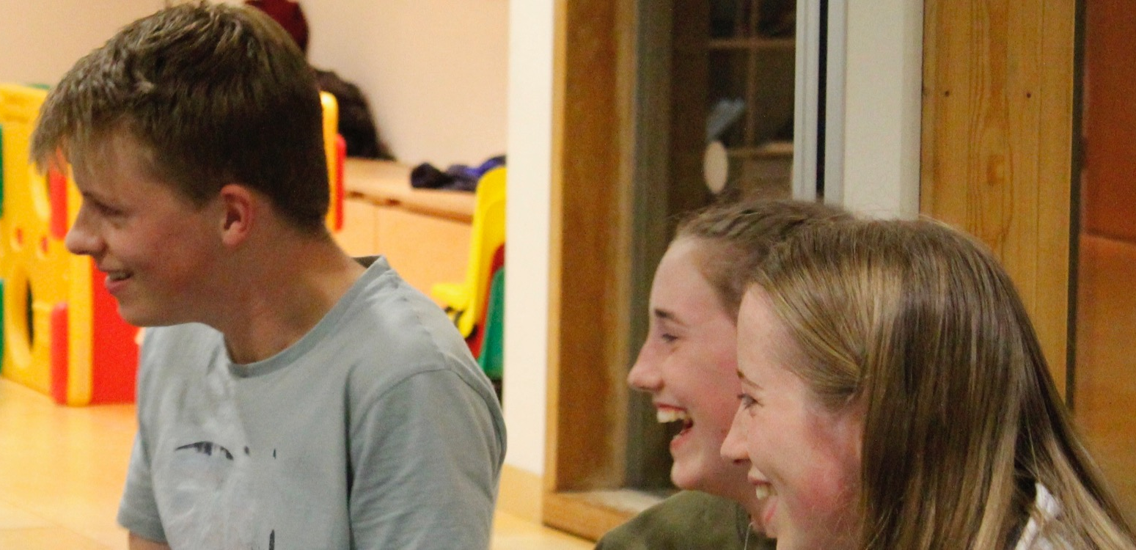
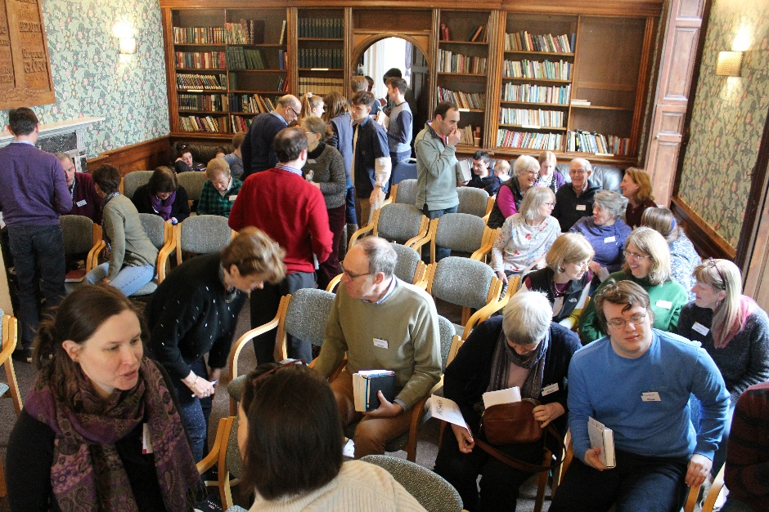
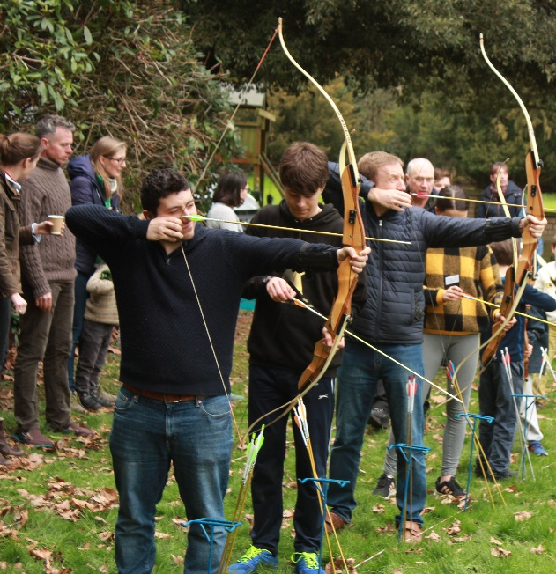
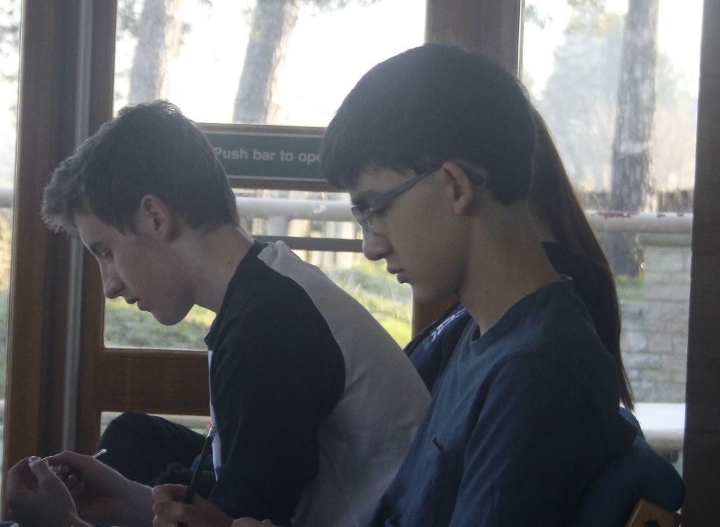
…enables All Saints to do so many things.

Slide 9
All Saints has appointed a Safeguarding co-ordinator to take responsibility for supervising our Safeguarding.
Polly Stanton (safeguarding@allsaintslittleshelford.org)
We have also appointed an independent children's advocate who can be contacted for advise and support if children are in difficulties.
Caroline Kingdon (advocate@allsaintslittleshelford.org)
Our churchwardens can be reached via email. (wardens@allsaintslittleshelford.org)
Diocesan Safeguarding Adviser
Rebecca Boswell (rebecca.boswell@elydiocese.org)

Slide 10


