Slide 1

Safeguarding
in
Pictures

Slide 2






It is usual to follow advice, rules and instructions and take steps to …

Slide 3
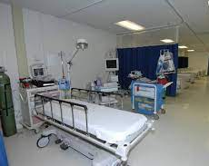
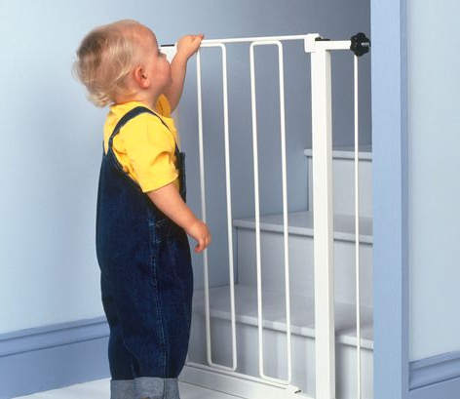
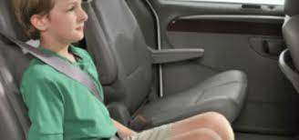
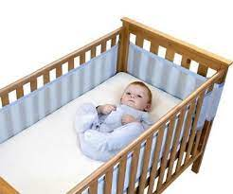
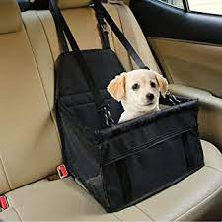
… protect the vulnerable.

Slide 4
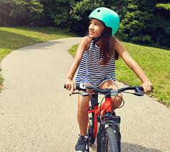
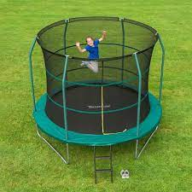
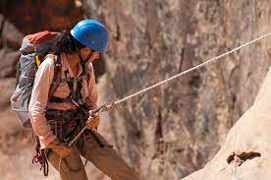
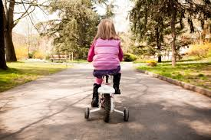
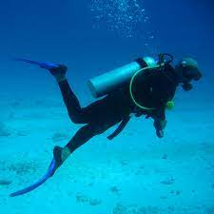
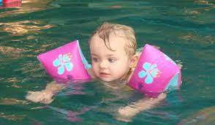
… protect us when we could be in danger.

Slide 5
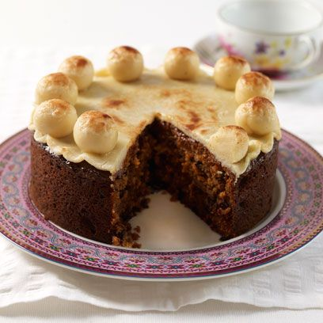


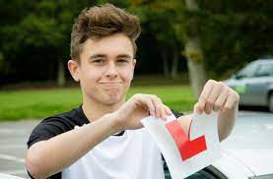
… ensure that everything works out well.

Slide 6
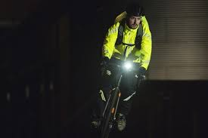
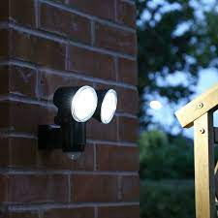
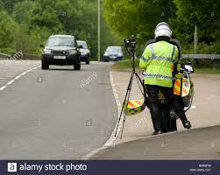
We also make sure that we can see and know what is happening …
…and be seen.
We signal that rule breaking is not acceptable.

Slide 7
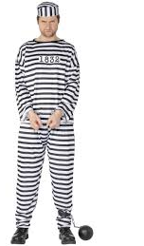
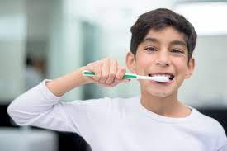

Safeguarding rules do not restrict us.
They are like a good habit which…

Slide 8
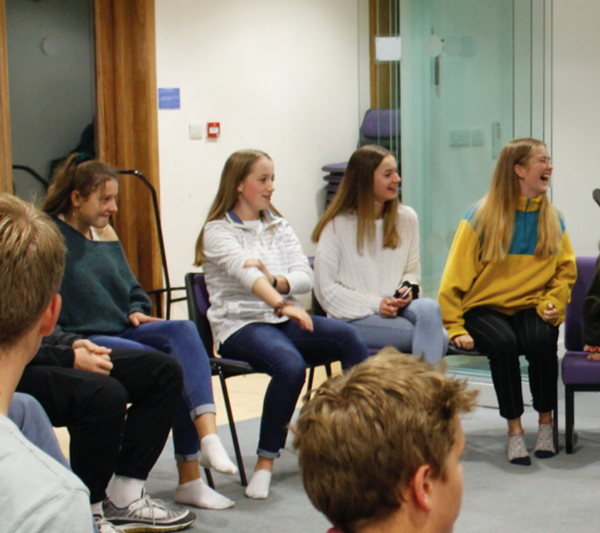
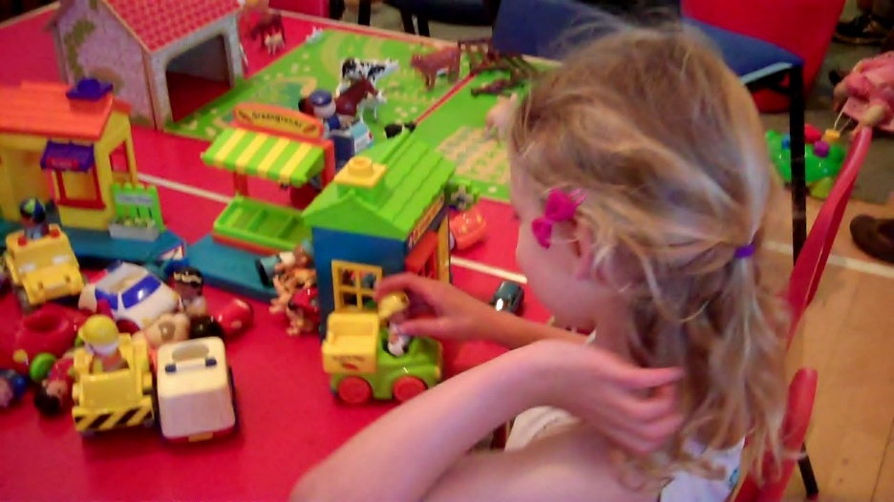
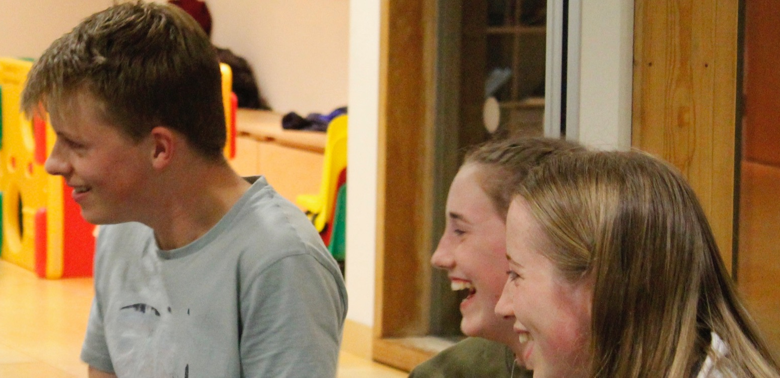
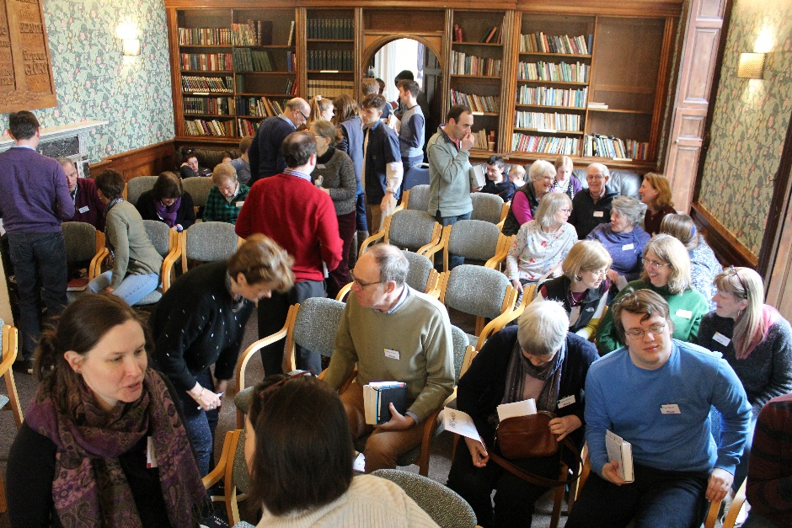
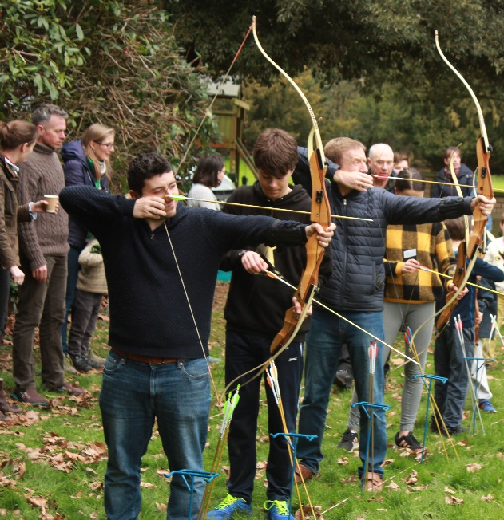
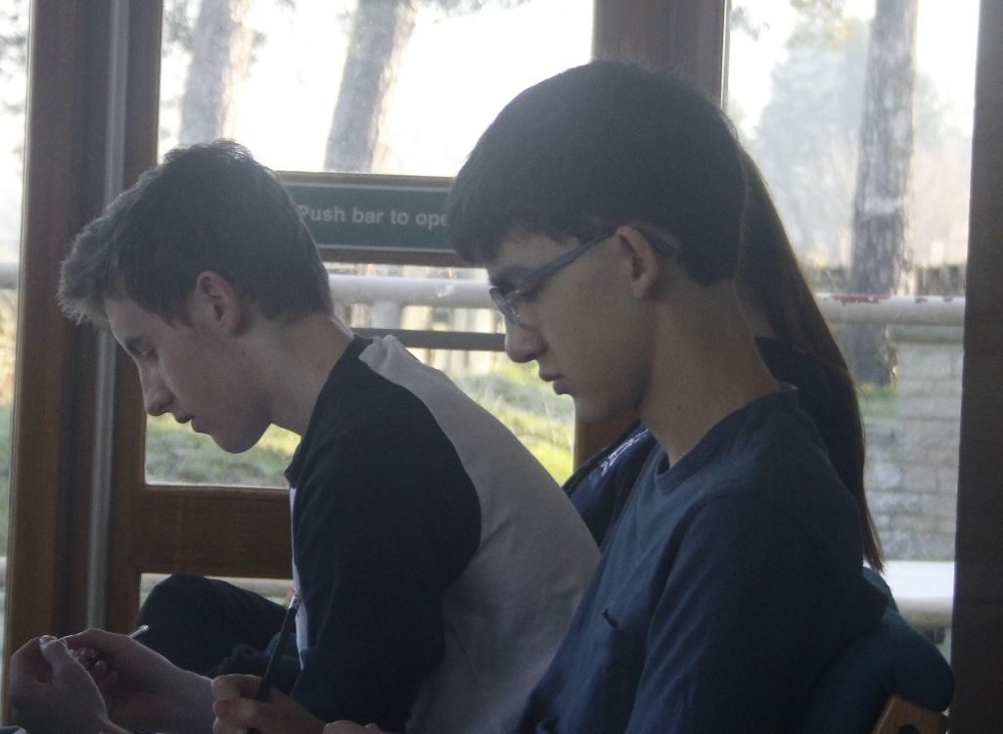
…enables All Saints to do so many things.

Slide 9
Safeguarding Concerns
If you have a Safeguarding concern about a child, a young person or a vulnerable adult there are various people to contact.
The clergy:
• Simon Scott: 07739 984323 | simon.scott@allsaintslittleshelford.org
• Gideon Emmanuel 07565 867099, gideon.emmanuel@allsaintslittleshelford.org,
Otherwise please contact either of the churchwardens: Justin Cross or Jane Greaves at wardens@allsaintslittlshelford.org.
Our Church Council member appointed to advise on Safeguarding matters is Polly Stanton on 01223 722509
You are always able to contact the Diocese of Ely Duty Safeguarding Number: 01353 652747 - this number is monitored 24 hours.

Slide 10


